Slide 1
ROBOSOFT ENERGY EFFICIENCY
MONITORING SYSTEM

Slide 2
WHAT IS THE ENERGY PLANTS
REQUIREMENTS?
Your plant is efficient?
Can you analysis your data?
What we will do for increasing efficiency with data acquisition?

Slide 3
EFFICIENCY AND FORECAST?
Turbine efficiency
Operators efficiency
Machine efficiency
Use resources at the optimum level
Analysis the fault with predictive maintenance
Machine energy efficiency…
Energy production forecast

Slide 4
DATA ACQUISITION FOR THE PREDICTIVE ANALYSIS?
Without data, you can not measure the efficiency of your investments!
Without the data, you can not have your competitive power!

Slide 5
DATA ACQUISITION IN ENERGY SECTOR
Production and consumption in power plants
Analysis the alarms
Downtime analysis
Wind speed analysis
Differences between forecast and actual
Analysis of system information
Maintenance operations
Loss

Slide 6
RBS Report® DATA ACQUISITION SYSTEM
POWER PLANT
GEOTHERMAL
EXCEL
POWER BI
CENTRAL SCADA
CLOUD SQL SERVER
RBS MOBILE EXCEL
ANY TYPE OF
SENSOR
RESTFULL JSON API
POWER PLANT
HYDRO
RBS MOBILE TREND
RBS REPORT
AZURE SQL SERVER
RBS CLOUD
RBS CLOUD EXCEL
POWER PLANT
WIND
REACT VR TECH
AWS SQL SERVER
RBS CLOUD TREND LIVE
ANY TYPE OF
FACTORY
RBS CLOUD TREND HISTORICAL

Slide 7
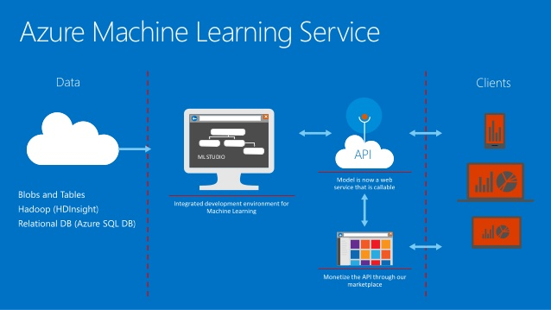
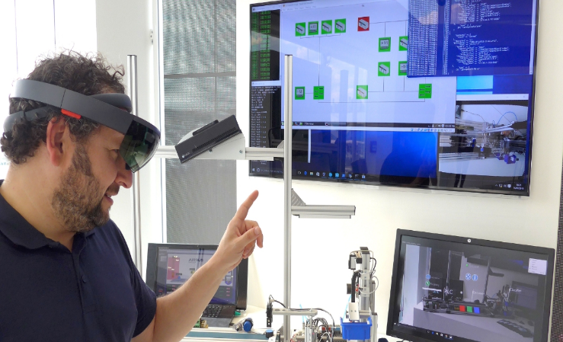
MACHINE LEARNING-PREDICTIVE MAINTANENCE

Slide 8
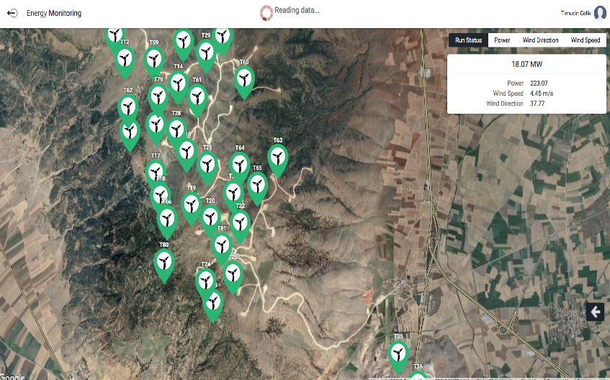
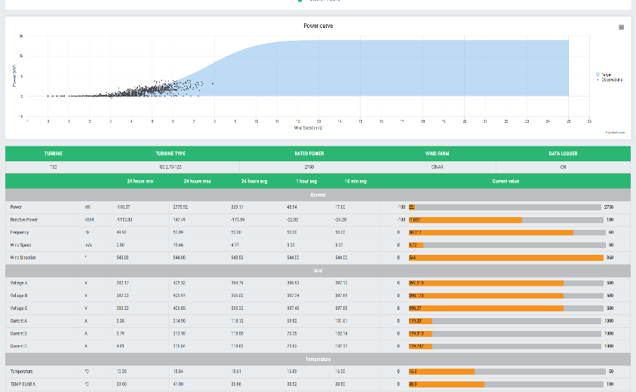
RBS Report® MOBILE LIVE PRODUCTIVITY MONITORING
The RBS Report® system has the ability to analyze alarms, power generation, consumption and all analog-digital datas of HEPP, Wind Energy and Geothermal Plants, Solar, Biogas, and all type energy plants by using industrial BI and data acquisition tools.
With summary reports, there is a structure that provides system efficiency from CEO level to maintenance managers.
It is integrated with all mobile systems.
Live system and plant efficiency

Slide 9
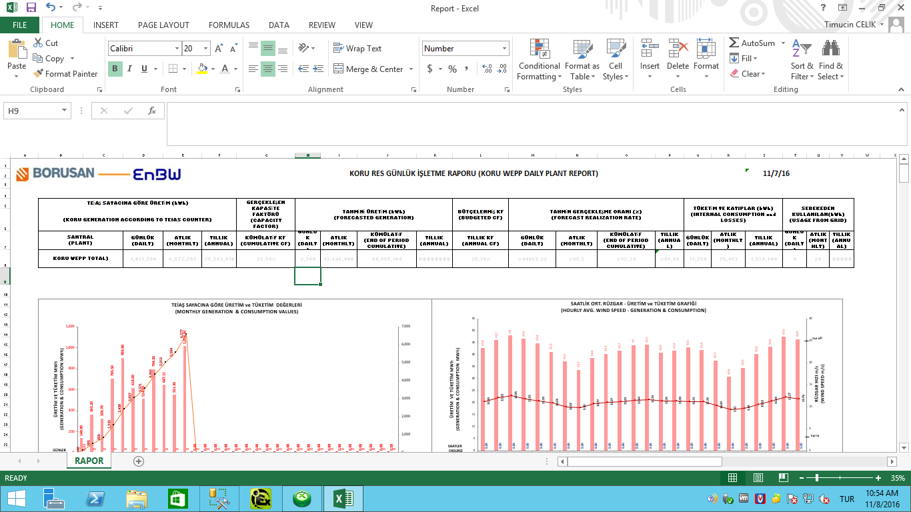
BORUSAN EnBW
(Sample excel dashboard for wind energy plants; our cloud reporting system has unique structure in historian software)

Slide 10
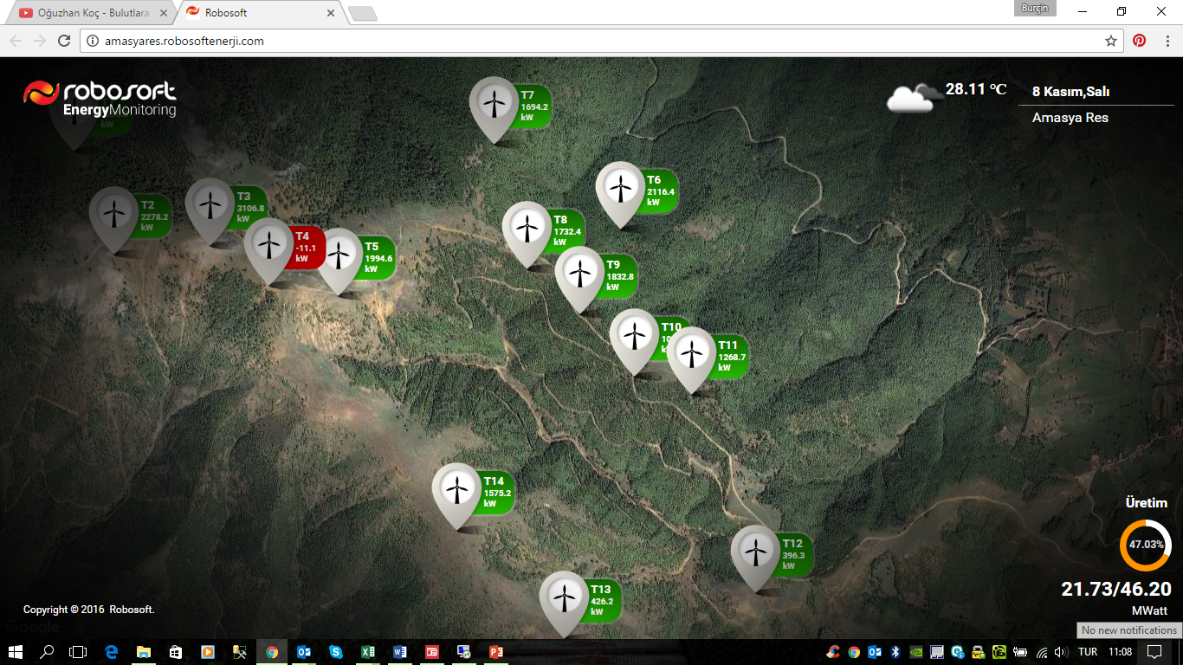
WIND ENERGY MONITORING SYSTEM
( Tablet and mobile monitoring; we can create custom monitoring system on cloud)

Slide 11
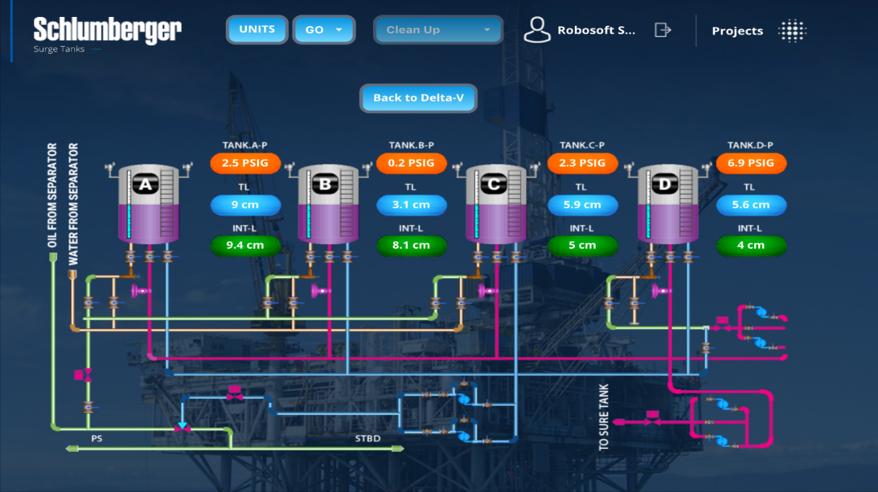
OFFSHORE ANALYZE AND MONITORING SYSTEM
( Tablet and mobile monitoring; also we focus on petro chemical software system, custom MES, mobile monitoring and maintanence software )

Slide 12
OUR SECTORS
Chemical
Water and waste water
Offshores
Food
Textiles
OEE projects
Renewable energy plants
And all kind of industries
Biogas
because of RBS Report flexibility

Slide 14
THANK YOU

